Slide 1


ETL Using Tableau Prep
Instructor: He Li

Slide 2
The Process of Data Analysis
Accessing data sources
Combining tables
Transforming variables and cleaning data
Exploring and describing data
Visualizing patterns in the data
Analyzing and modeling data

Slide 3
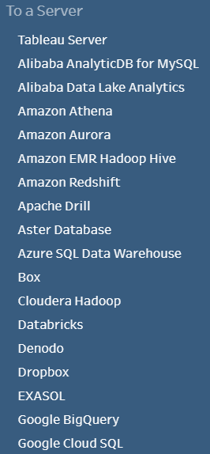
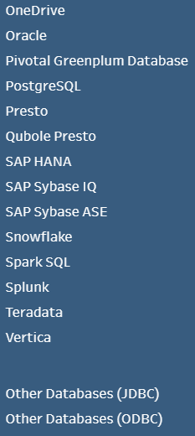
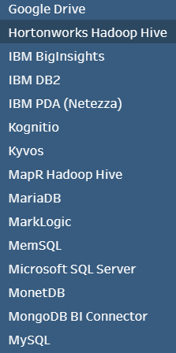
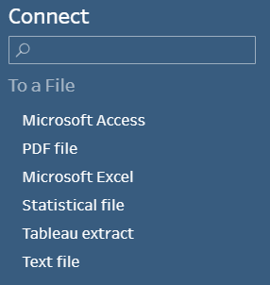
Common Data Formats
Tableau Prep can read and use data from a variety of different formats.

Slide 4
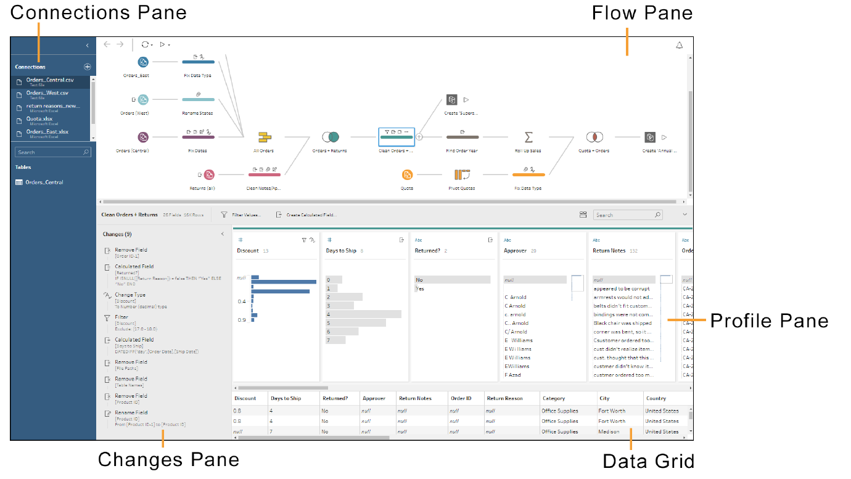
The Tableau Prep Workspace
add connections to data
Notes:
The Tableau Prep workspace consists of the Connections pane to connect to data, and three panes that work together to provide visibility into your data preparation.
The Connections pane on the left side of the workspace shows the data connections.
The + icon allows you to add connections to data.
The databases and files you are connected to are listed.
The tables you can work with in the flow pane are shown.
You can minimize the Connections pane by using the < icon
The flow pane at the top of the workspace is a visual representation of the steps that are created as you prepare your data.
There are different types of steps used in a flow to clean, shape, combine, and output your data.
When you click on a particular step, the profile pane and the data grid show details for the data at that point in the flow.
The profile pane in the middle of the workspace shows the structure of your data for that step in the flow.
The profile pane shows a summary of the fields in your data sample.
A histogram shows the data distribution of each field to help you quickly find nulls and outliers.
The toolbar and the context menus for each field show the operations you can perform during that step in the flow.
The contents of the profile pane will vary depending on what type of operation you are on in the flow.
You can minimize the profile pane using the √ icon.
As you clean your data, the operations you perform are listed in the Changes pane within the profile pane.
You can show the Changes pane using the > icon in a cleaning step.
All cleaning operations are recorded.
Click on a particular change to see the details about that operation at that point in the flow.
The data grid at the bottom of the workspace shows the row level detail for your data at that step in the flow. The data in the data grid reflects the selections in the profile pane.

Slide 5
The Tableau Prep Workspace
Notes:
When an input is selected in the flow pane, the profile pane becomes the Input pane. Here, you can view and edit input settings and fields.

Slide 6
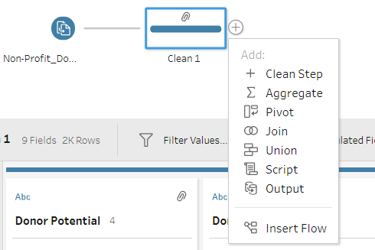
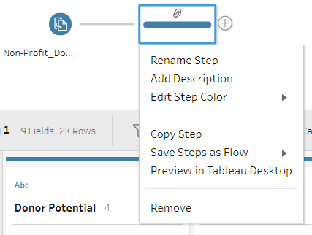
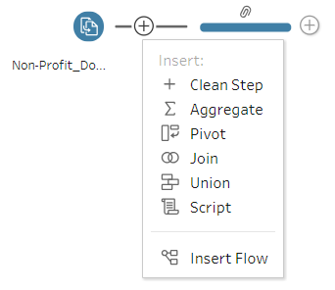
Types of Steps in Tableau Prep
add a new step
Right Click
rename, add description, copy, remove …
Notes:
The flow pane shows you all the data preparation steps that you applied to your data. Each step in your data preparation process is represented visually in the flow that you create and control.
To add a new step, click the + icon to the right of any step.
You can rename any step in the flow to be more descriptive.
You can also write a description for the step by right-clicking on a step and then clicking Add Description.
You can insert and remove a step in a flow.
You can disconnect and reconnect steps in a flow.
A branch can be used to split a flow.
Use an output step to save or publish your cleaned data.
You can save your flow and open it later to add or edit steps.

Slide 7
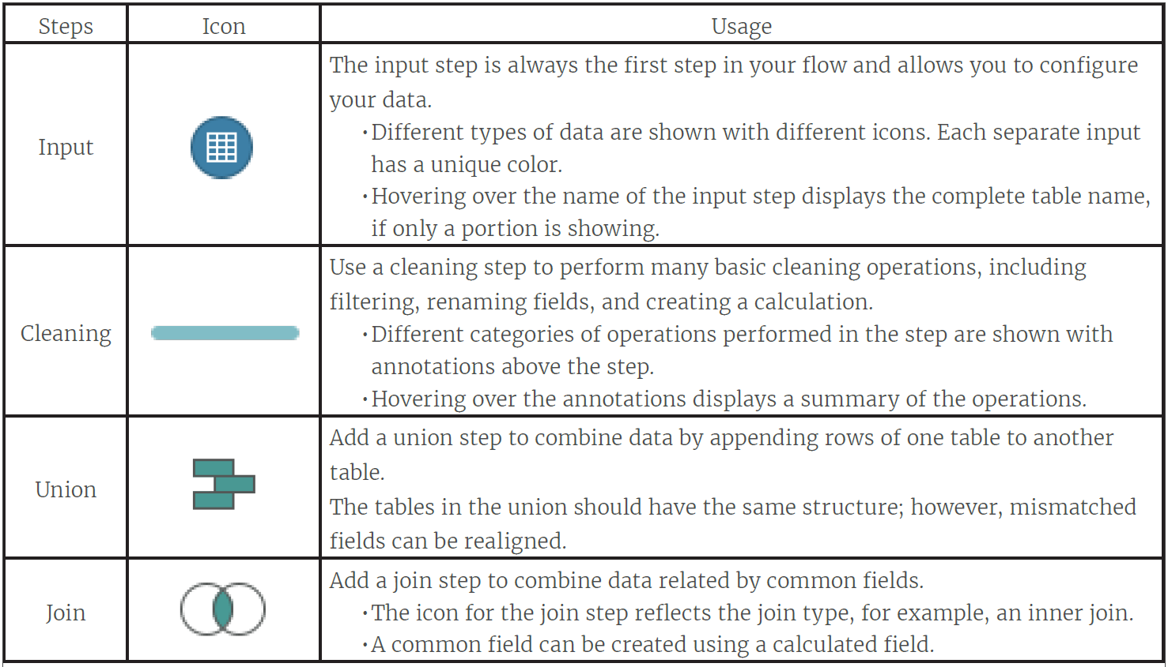
Types of Steps in a Flow

Slide 8
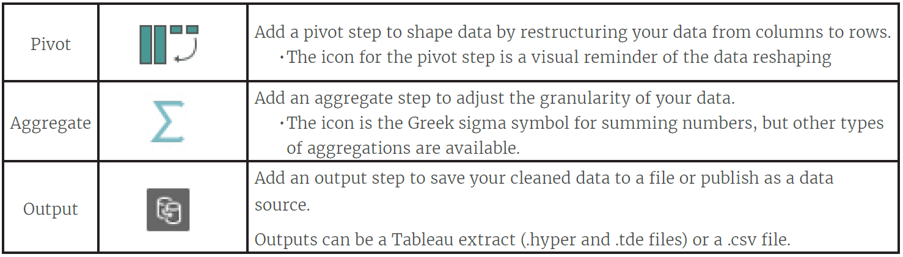
Types of Steps in a Flow (cont.)

Slide 9
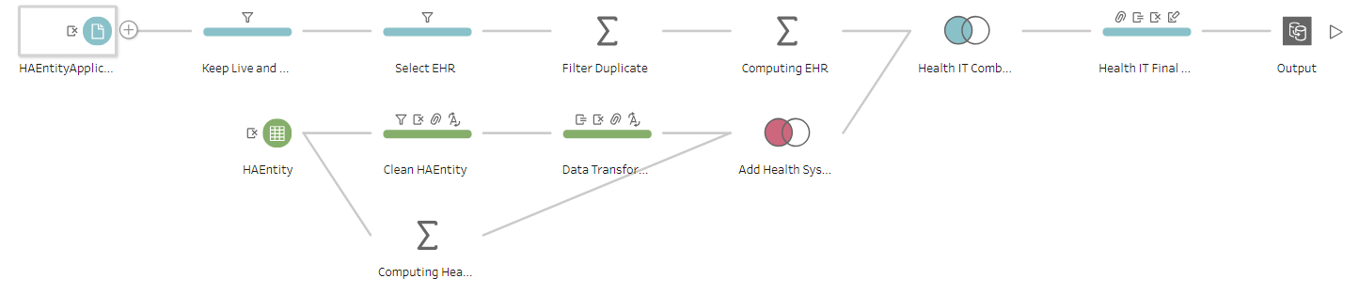
Hands-on Practices
(Self-Study, Introductory) Tableau Prep Free Training Video: https://www.tableau.com/learn/training#prep
https://www.tableau.com/learn/tutorials/on-demand/cleaning-step?product=tableau_desktop%2Btableau_prep&version=tableau_desktop_2019_3%2Btableau_prep_2019_3_1&topic=tableau_prep
(Self-Study, Introductory) Tableau Prep Help: https://help.tableau.com/current/prep/en-us/prep_whatsnew.htm
In-Class Demo: To give you a more hands-on experience and see how to work with real-world data, I use a very small part of my research project to demonstrate how we can use Tableau Prep in data processing (i.e., ETL process).

